Slide 1

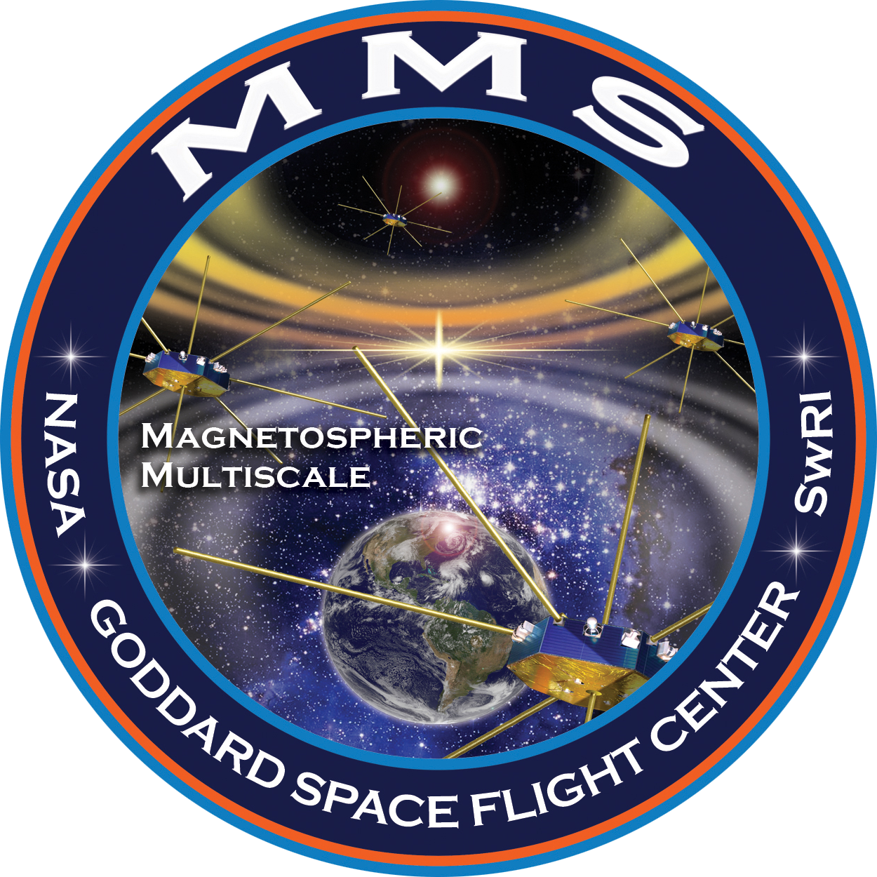
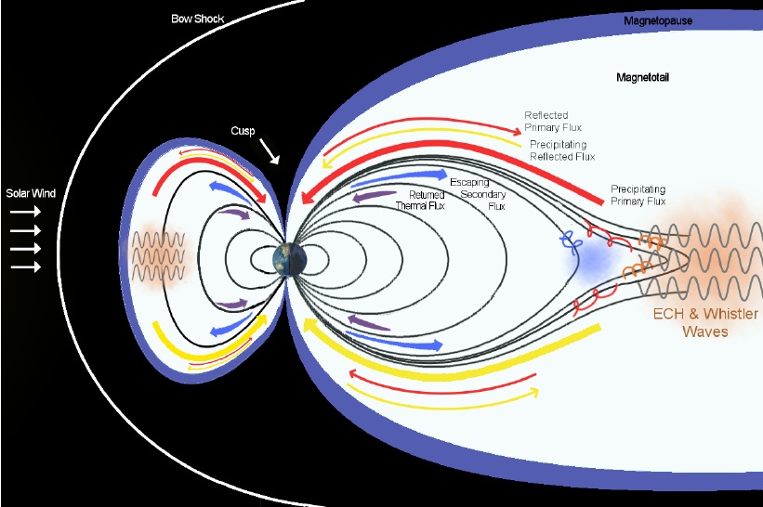
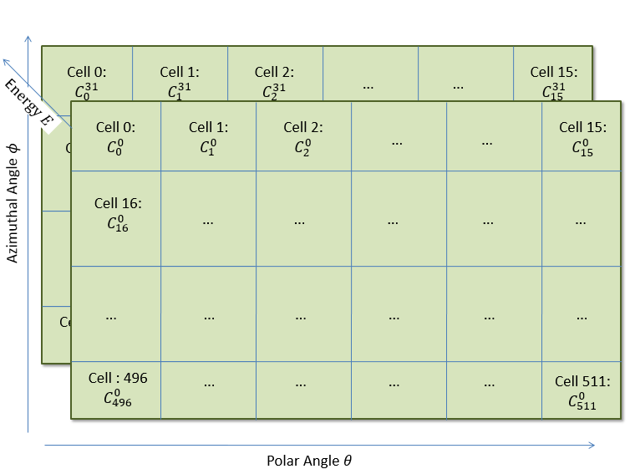
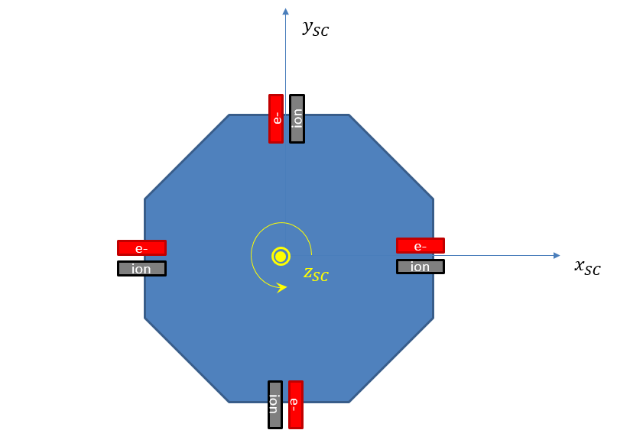
Two MCP stacks
Differential Electron Flux Spectra Measured by the MagnetosphericMultiscale Mission (MMS) Show Strong
Field-aligned Electron Population of Ionospheric Origin
C. Schiff¹, George V. Khazanov¹, Barbara L. Giles¹, Levon A. Avanov^{1,2}
J.L. Burch³,V.N. Coffey⁴, J.C. Dorelli¹, D. Gershman^{1,2}, B. Lavraud⁵, T. E. Moore¹, W.R. Paterson¹, C.J. Pollock⁶,C.T.Russell⁷,Y. Saito⁸, J.-A. Sauvaud⁵,R.J. Strangeway⁷
Levon Avanov^{1, 2}, Craig Pollock¹, Ulrik Gliese^{1, 3}, George Khazanov¹, Dan Gershman^{1, 4}, John Dorelli¹, Alexander Barrie^{1, 5}, Barbara Giles¹, Chad Salo^{1, 6}, Charles Dickson^{1, 7}, Arthur Jacques¹,
Roy Torbert^{8, 9}, Christopher Russell¹⁰ and Robert Strangeway¹⁰
¹NASA Goddard Space Flight Center, Greenbelt, MD, ²University of Maryland, College Park, MD, ³SGT Inc., Greenbelt, MD, ⁴Oak Ridge Associated Universities, Washington, DC,
⁵Millenium Engineering and Integration Company, Arlington, VA, ⁶Stellar Solutions, Chantilly, VA, ⁷AS and D, Inc., Beltsville, MD, ⁸University of New Hampshire,
⁹Southwest Research Institute, ¹⁰University of California, Los Angeles
UV source
Counterstreaming electrons
Counterstreaming electrons
Counterstreaming electrons
Overview of the MM3/FPI and magnetic field data for May 6-7 of 2015.

